Slide 1
Working in the web
and being different
Julien RIO
www.julienrio.com
14/06/2012
Hong Kong PolyTechnic University

Slide 2
What is web design all about?
Making yourself different
Making your work different
How to advertise online
Last but not least

Slide 3
What is webdesign all about?
Is webdesign really about…web-design?

Slide 4
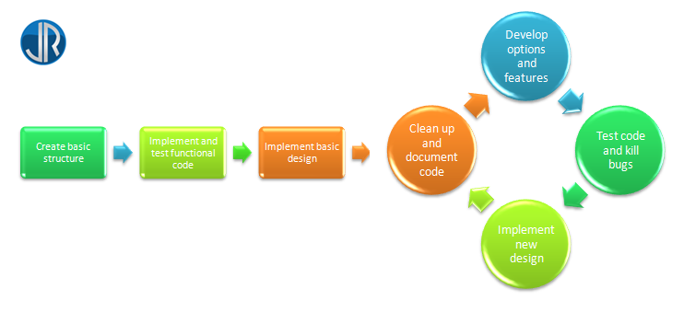
Webdesign, the importance of the code
A clean code is the key to an efficient website
Webdesign is all about coding…
- creating a clear & efficient code
- cleaning the code & killing bugs
- documenting the code & structure
- always making it faster & smoother
- …

Slide 5
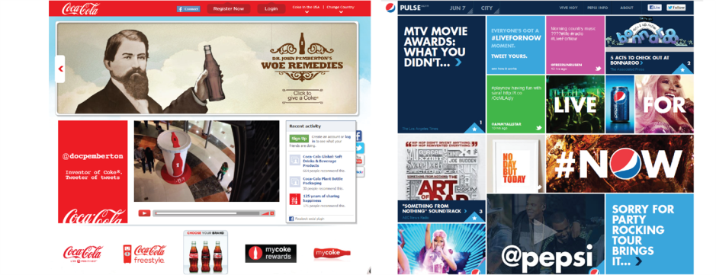
Webdesign is all about creativity & design
Differentiation and competitiveness
Webdesign is all about design…
Coca Cola
Nike
Pepsi
Reebok
Traditional
Cultural
Clean
Informative
LifeStyle
Interactive
Sober
Original
Global
Messy
Entertaining
Product
Clean, simple
Acid

Slide 6
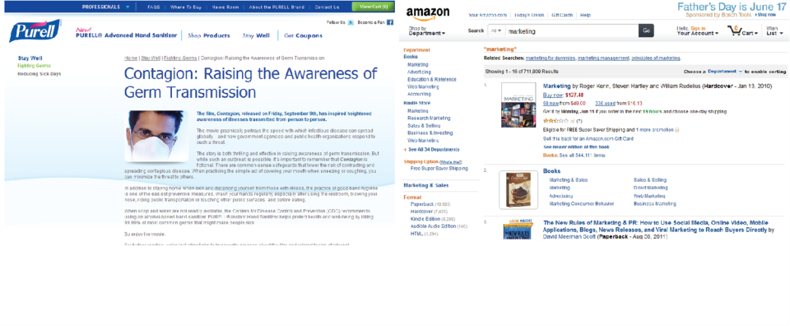
Webdesign is all about content
What makes your page more interesting?
Webdesign is all about content…
- creating smart & interesting content
- making use of keywords
Purell
Amazon
Large content
Targeted keywords
Little content
Long tail theory

Slide 7
Webdesign is a multi-layered work
… that involves multiple people and departments
Marketing team
Content
Designer / webdesigner
Design & UI
Webdesigner
Code

Slide 8
The other layers of Webdesign
Webdesign isn’t “all about” content, code, design & UI…
SEO
SEM
Content
Code
Design & UI

Slide 9
Making yourself different
Stand out of the crowd

Slide 10
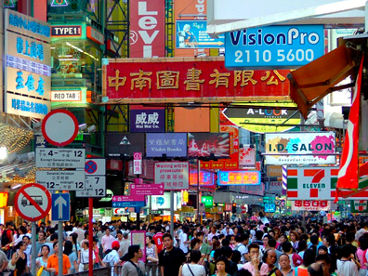
The Hong Kong environment
A highly competitive place

Slide 11
Be the best in what you do!
There is a simple way for being different
Be different!
(You don’t have to be the best in anything, master your field and widen your knowledge)
Master a few coding languages
Practice the main design software
Learn marketing and SEO concepts
Analyze your work & learn from your mistakes
Be creative and think out of the box!
Be the best programmer
Know all languages
Be the fastest
Be the best designer
Know all design software
Be the most creative
Be the best marketer
Know all concepts
Create efficient strategies
Create the cleanest code
Generate statistics reports
Think as a customer

Slide 12
Making your work different
Concepts of SEO & SEM

Slide 13
Basics of SEO
What is SEO?
Search Engine Optimization
Internal links and back links
W3C compliance
Code cleanliness
Keywords & content
Unique Metatags
Pictures alt attributes
…

Slide 14
SEM
Why choosing Web marketing & Web Advertising?
Search Engine Marketing
Being creative – the world’s best job
Using the right tools – Wario Land: shake it!
Using empathy – prototyping your website on paper
Notes:
How to handle employees blogging

Slide 15
How to advertise online
Some key examples based on my personal experience

Slide 16
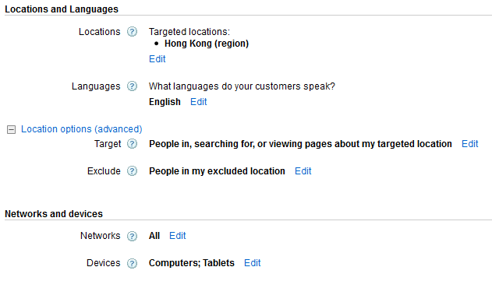
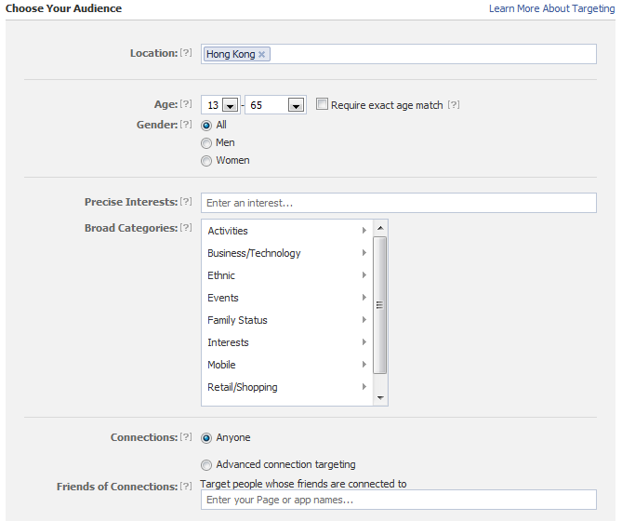
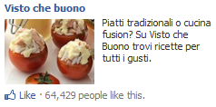
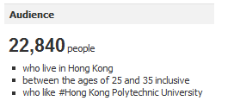
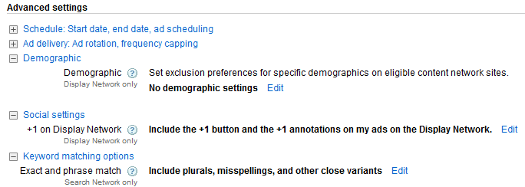
Google ads VS Facebook ads
What suits me best?
Google Adword
Facebook ads
Non graphic ads
Graphic ads
Appears on Google result – when people look for information
Appears on Facebook – when people are relaxing
Target on keywords – gives people what they are looking for
Target on people’s profile – gives people what they like
Uses basic demographic filters
Uses advanced filters

Slide 17
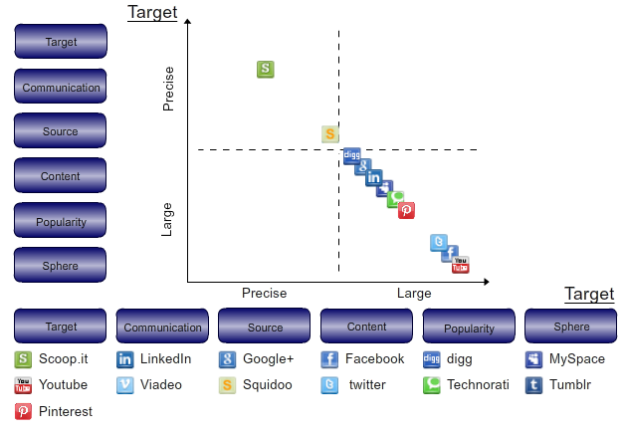
Which Social Media is the most adapted to my business?
How to choose the right Social Media?
Who uses Social Media for professional reasons?

Slide 18
Why using Social Media?
The good and wrong reasons for using Social Media platforms
Good reasons
Create a link with the consumers
Reach some niche markets
Wrong reasons
It is “trendy”
Get feedback from the market
It reaches everyone
Competitors do it
Offer special content

Slide 19
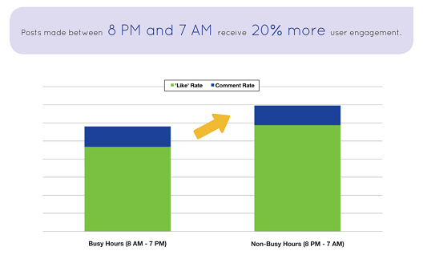
When to post on Social Media?
The optimal time to post news on your platform
At what time of the day would you post your news to get the optimal response?
Those numbers were studied for Facebook, but the analyze makes even more sense with Twitter
Source: Buddy Media, Strategies for Effective Facebook Wall Posts (2011)

Slide 20
The best frequency for online posting
How often would you post news to get the best response?
What do you believe to be the optimal posting frequency?

Slide 21
Last but not least
Analyze your results!

Slide 22
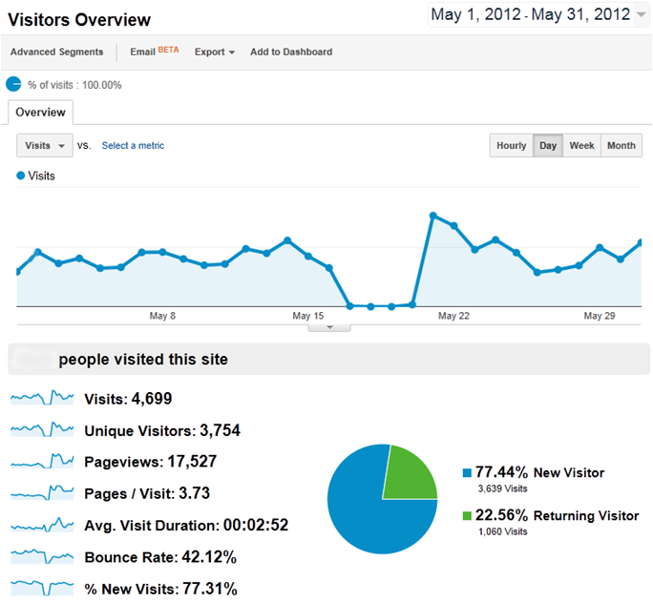
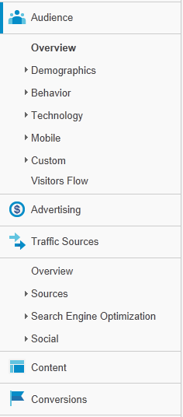
Google Analytics
A free & efficient way to keep track of all your actions

Slide 23
Thank you
Would you have any question, please feel free to ask

